Slide 1
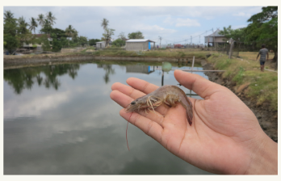
Prediksi Mikroorganisme pada Tambak Udang berbasis Neural Network
Muhammad Wafiq Kamaluddin (2210181042)
Advisor 1 :
Dr. Setiawardhana, S.T, M.T.
NIP. 197708242 00501 1 001
Advisor 2 :
Dr. Eng. Bima Sena Bayu Dewantara, S.ST, M.T.
NIP. 197612151 99903 1 003
Advisor 3 :
Dr. Eng. Agus Indra Gunawan, S.T, M.Sc
NIP. 197608212 00112 1 002

Slide 2
Outline
01
02
03
04
05
06
07
Background of The Study
Purpose of The Study
Problem Formulation
Scope and Limitation
Review of Literature
System Design and Progress
Progress Detail

Slide 3
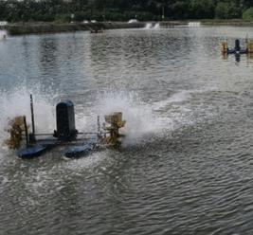
Background of The Study
Algae need to be estimated as important water quality indicator in shrimp farm production.
Usually, water quality is monitored based on water color on shrimp pond. The color show alga content as qualitative data. Based on that, prediction amount of algae will be very useful for estimation water change periode on water quality control

Slide 4
Purpose
Create a device to estimate the Microorganism content, based on light absorption
Implement Artifical Neural Network to predict alga content based data from device

Slide 5
Problem formulation
How to create device for data collecting
How to make good model for predict the sample

Slide 6
Scope and Limitation
Data collecting from conditioned sample
Prediction model is based data from prototype

Slide 7
Literature review
A. I. Gunawan, B. S. B. Dewantara, A. E. Pratama, I. Puspitasari, T. A. Setya. (2019). A Study for Estimation of Bio Organism Content on Aquaculture Pond Based on Image Color and Light Intensity. International Electronics Symposium on Engineering Technology and Applications (IES-ETA). Surabaya, Indonesia, : doi:10.1109/ELECSYM.2019.8901544.
O. Meiyanto, A. I. Gunawan, dan B. S. B. Dewantara. (2021, November). Studi Analisis Konsentrasi Warna Pada Cairan Pewarna Makanan Dengan Metode Pengukuran Optical Density. Briliant, Hal. 710-725.

Slide 8
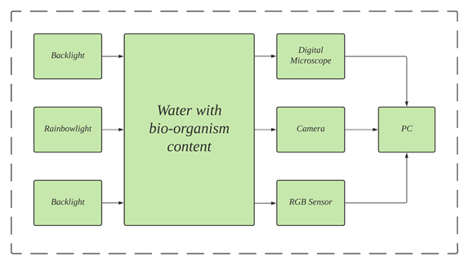
System Design

Slide 9
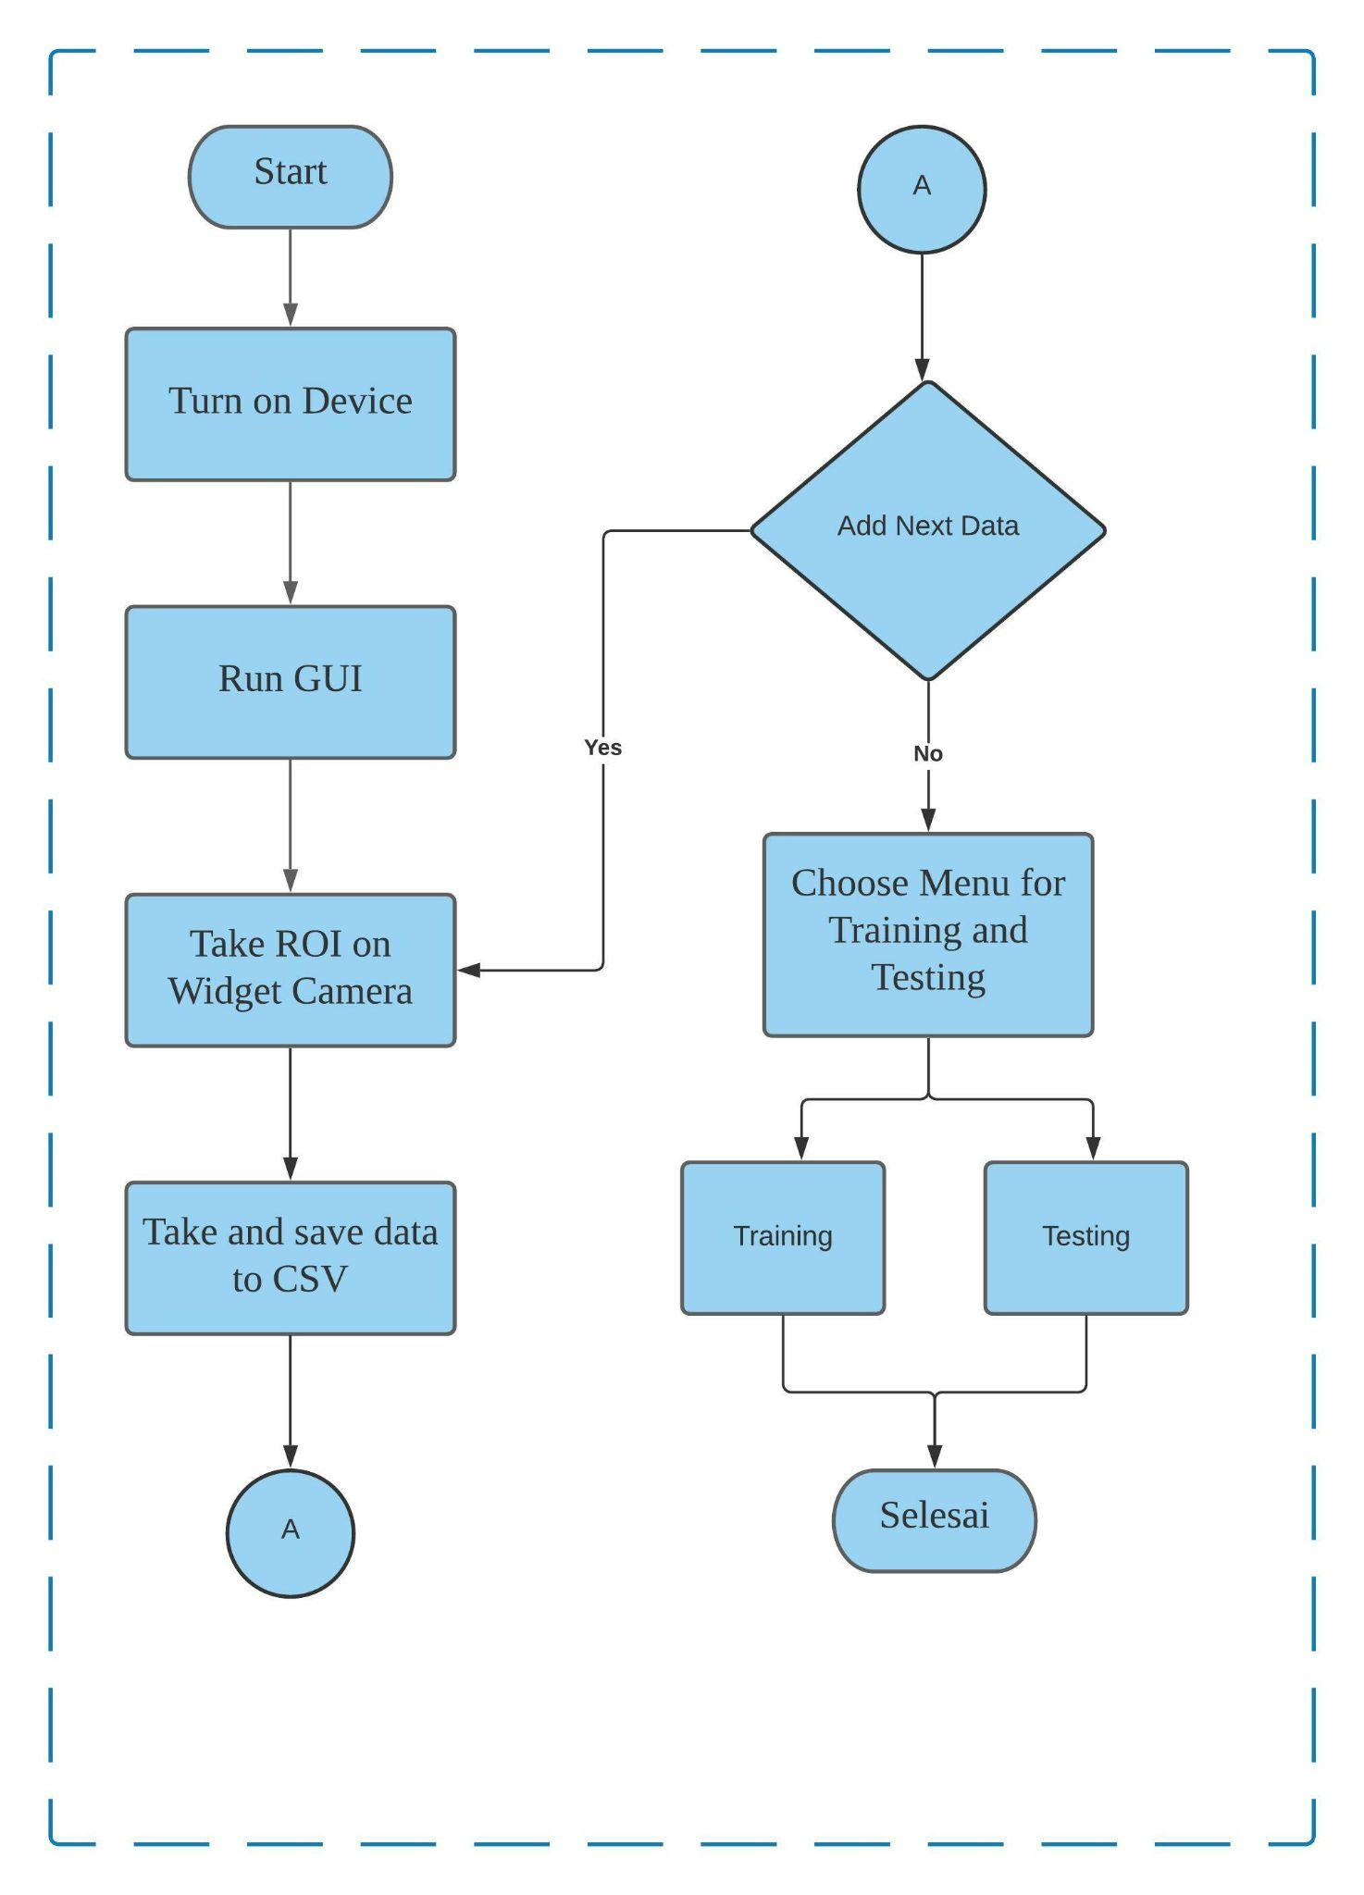
Flowchart

Slide 10
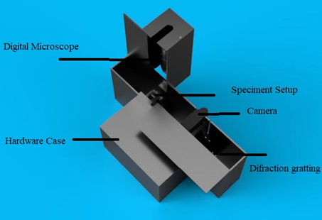
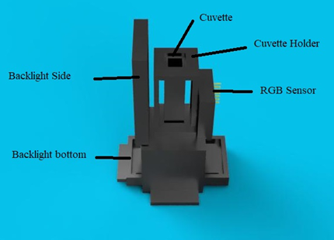
Mechanic

Slide 11
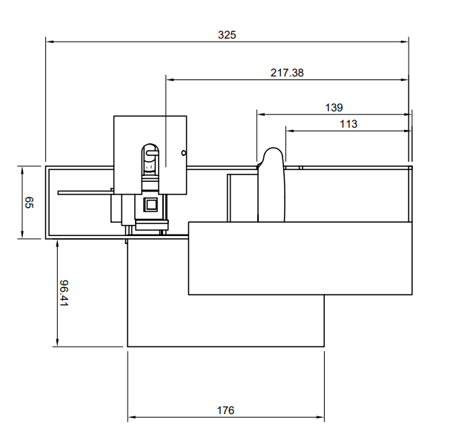
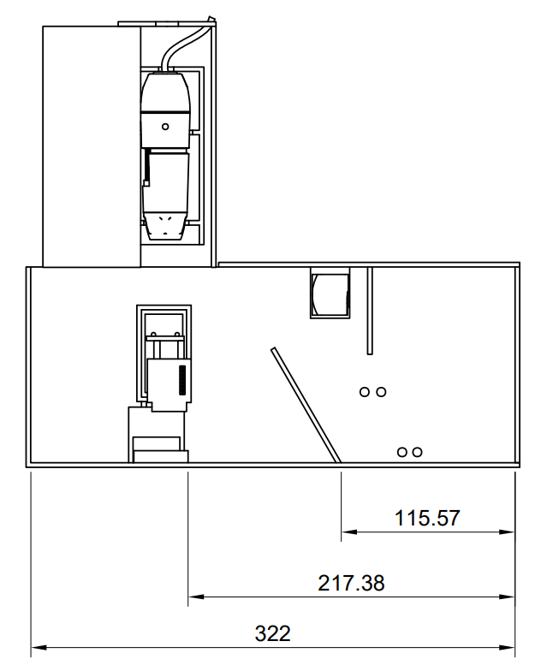
Dimension

Slide 12
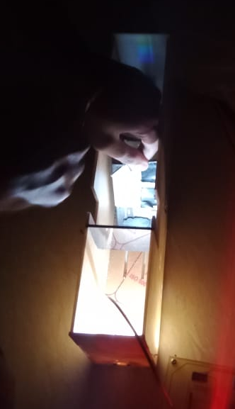
Mechanic

Slide 13
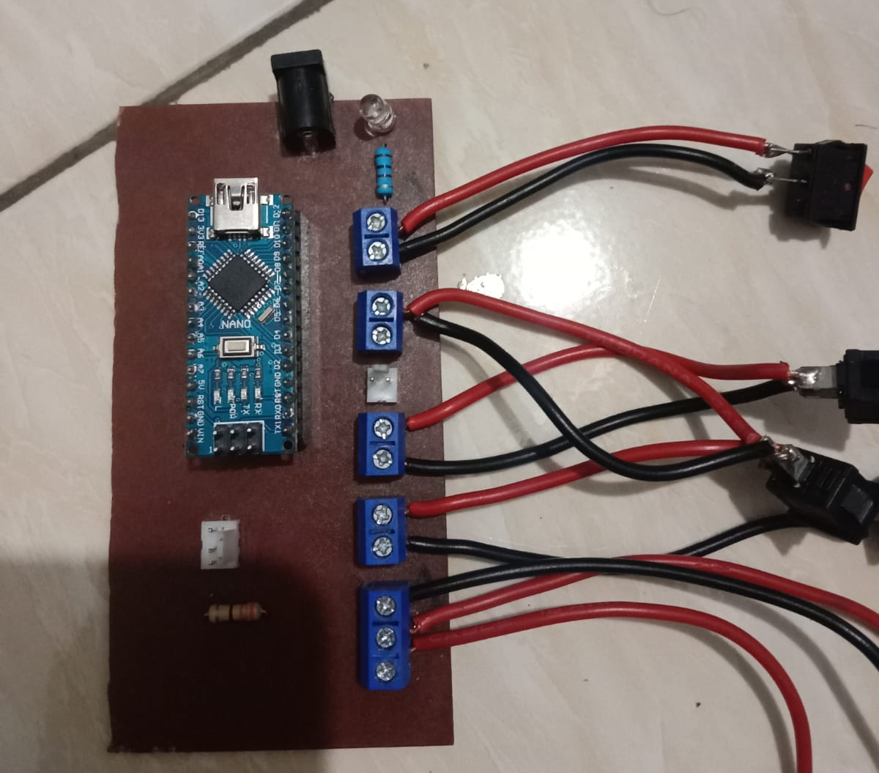
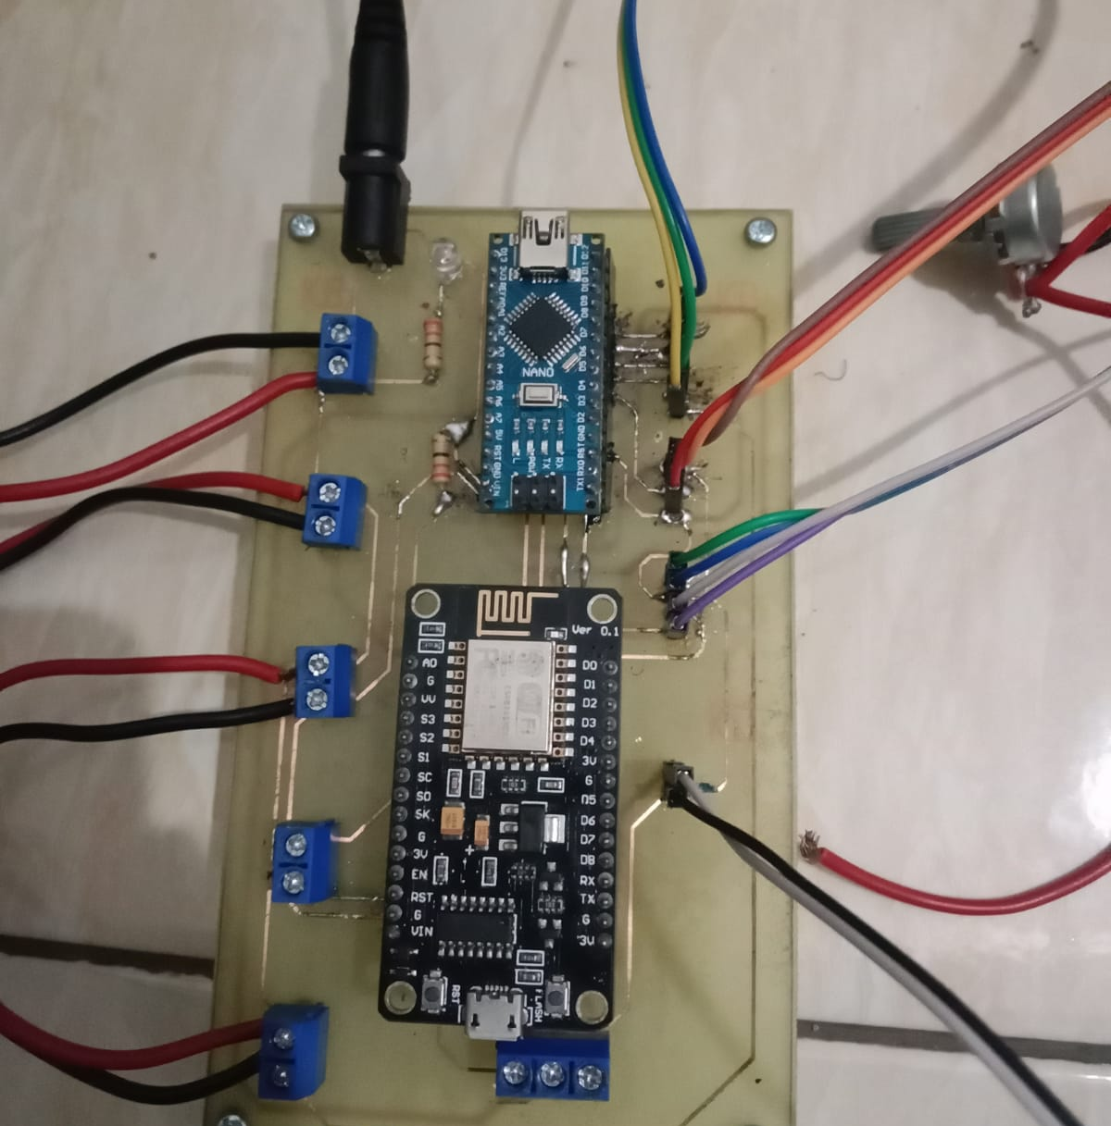
Hardware

Slide 14
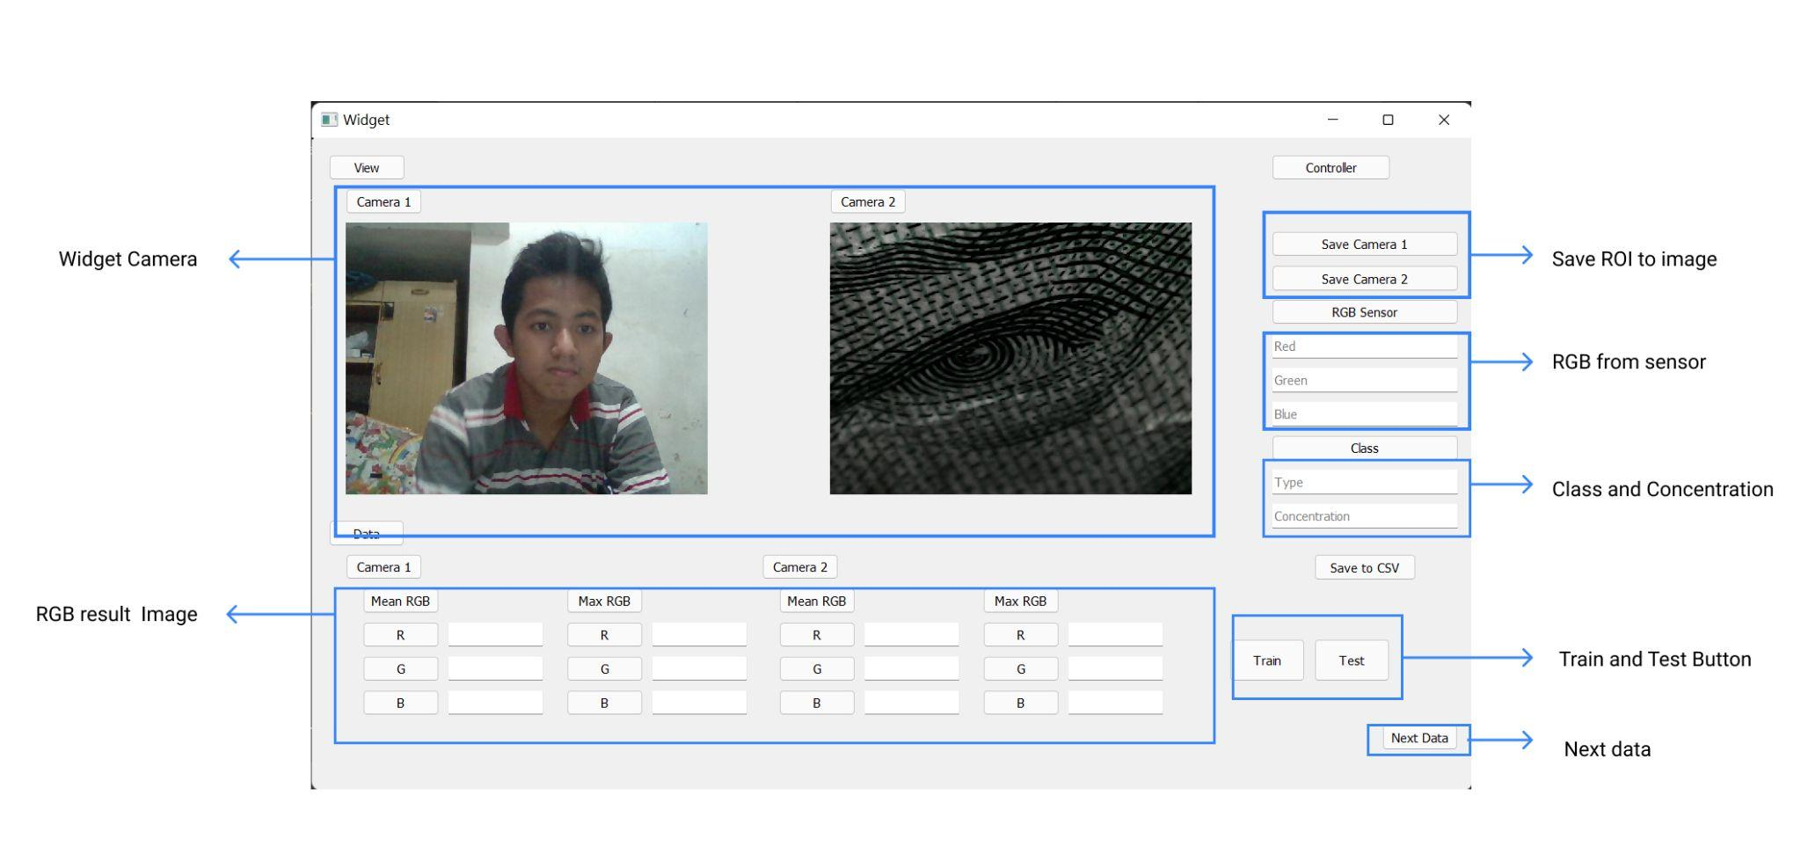
Software

Slide 15
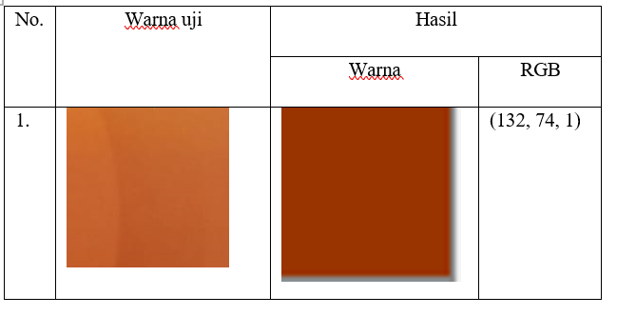
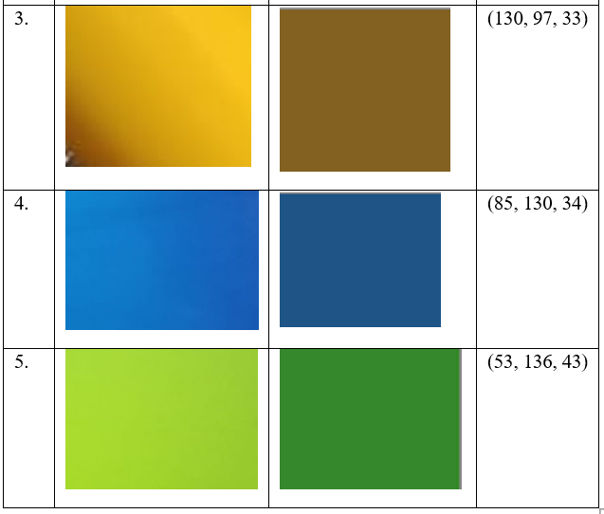
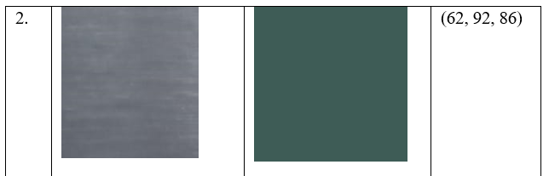
RGB Sensor

Slide 16
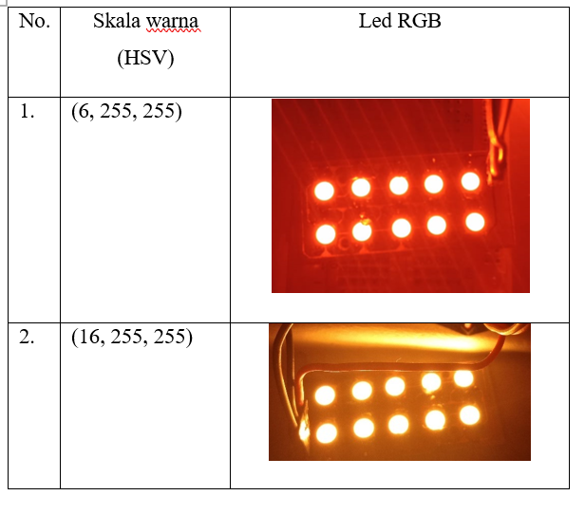
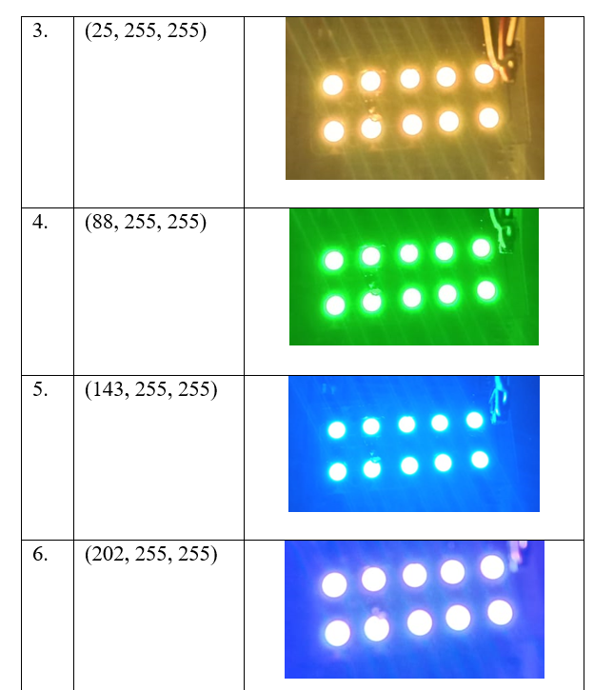
Backlight Control

Slide 17
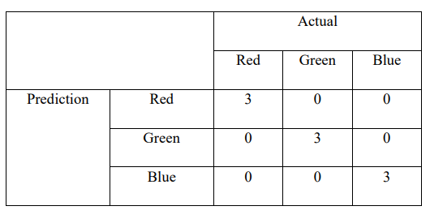
ANN Classification

Slide 18
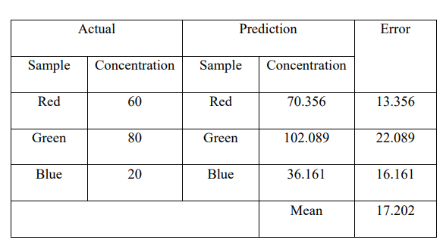
ANN Regression

Slide 19
Conclusion
System is running well but it still running partially
Neural network model using DNN is running well for classification and not quiet well for regression

Slide 20
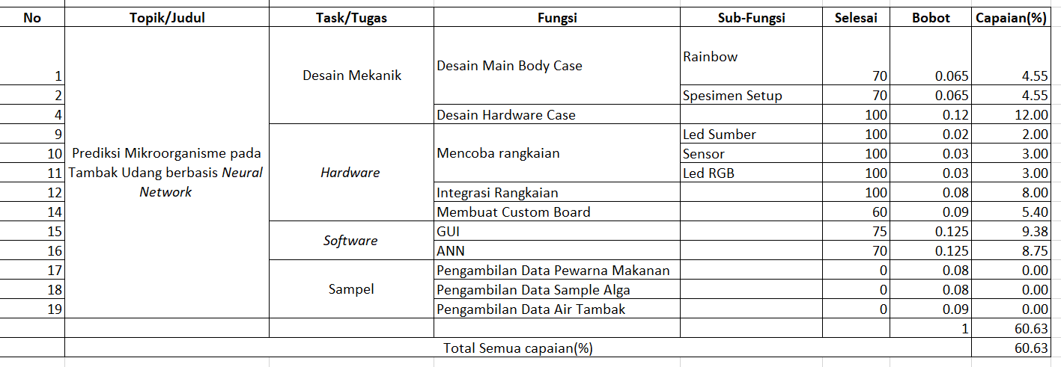
Progress

Slide 21
Thankyou

